Slide 1
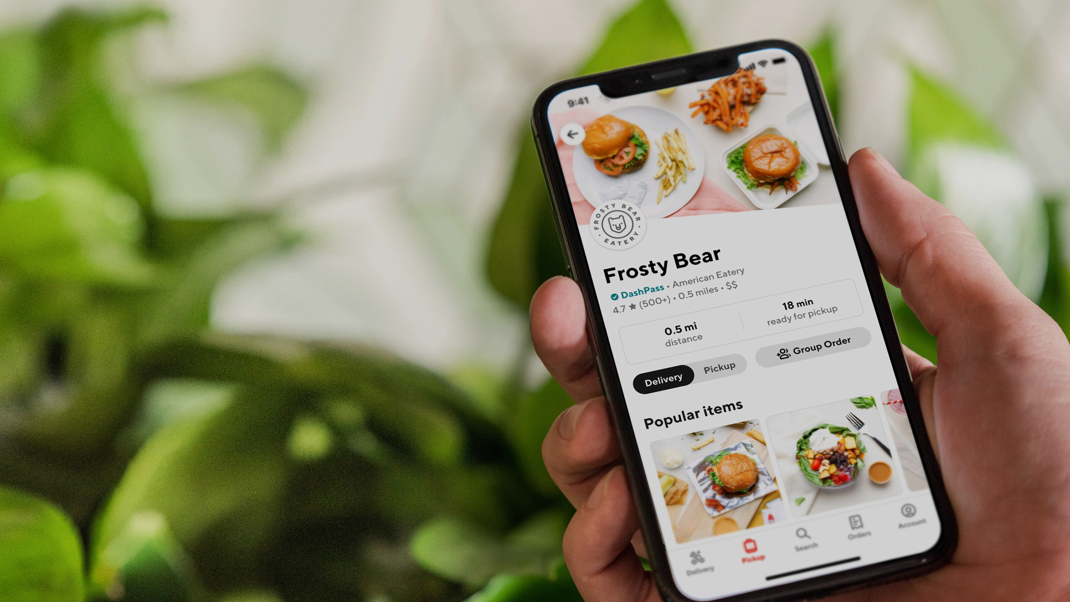

Optimizing Deals
Discovery
RESEARCH REPORT | JULY 2025 | KELLY PETERSON

Slide 2
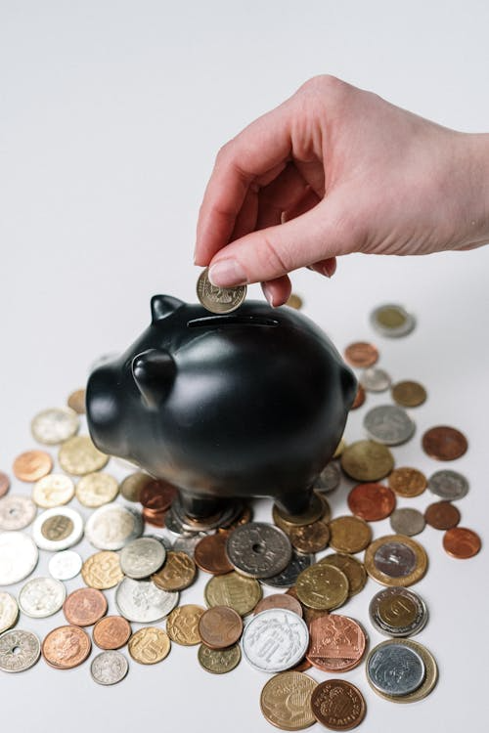
1
Background & Approach
2
Breaking Down “Discovery”
3
Research Recommendations
4
Next Steps

Slide 3

Background &
Approach

Slide 4
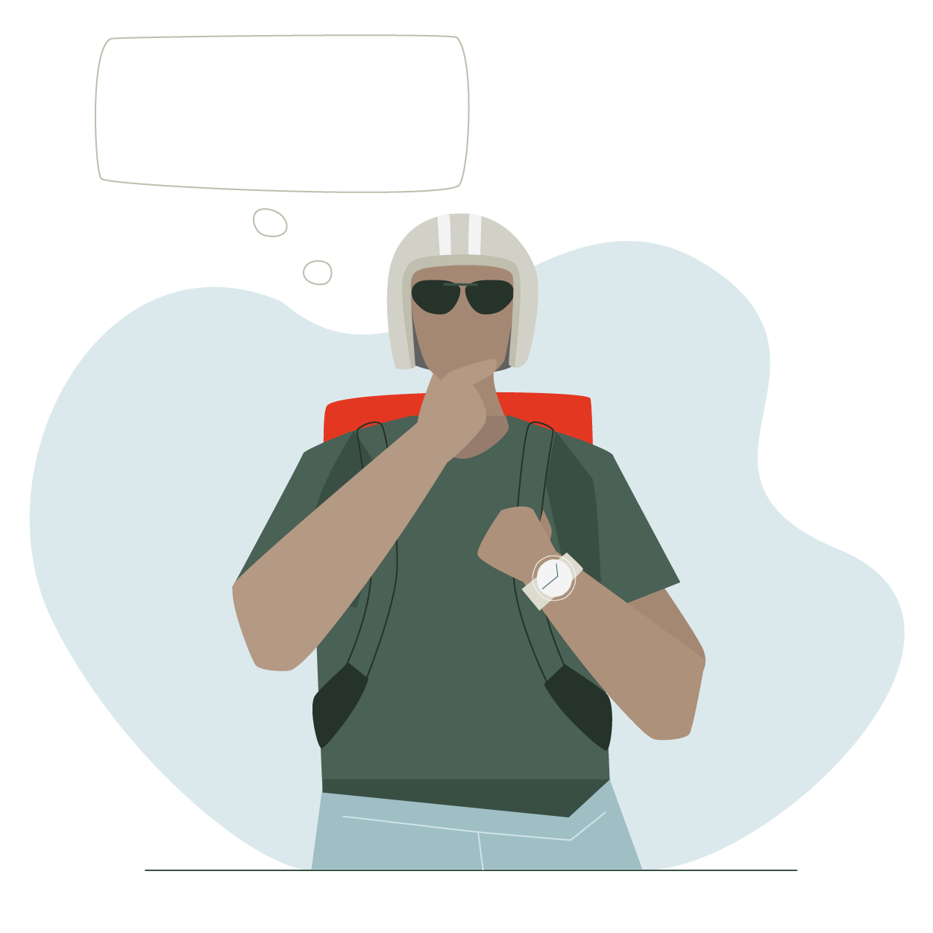

The Cx app is moving to more of a search-first experience to match Cx app intent. The ability to easily search for and find deals will be critical for price sensitive and deal seeking Cx.
This research aims to understand the preferred discovery pathways and ideal tools to help Cx find deals faster and encourage conversion.
¹ Making Decisions on DoorDash is Too Difficult for Cx, Grace Fletcher De Niear, May 2025

Slide 5

The research was anchored around three overarching questions:
To address this we conducted six 45-minute, one-on-one Zoom interviews with a mix of deal seeking Cx. Each session included exposure to potential search filters and results.
What are the pain points in the current deal discovery experience today?
What is the ideal deal discovery experience for Cx?
What tools would be helpful to narrow down search results?
Link to research brief

Slide 6
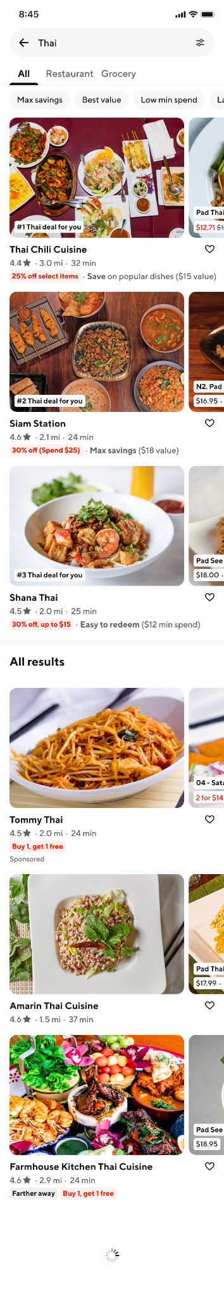
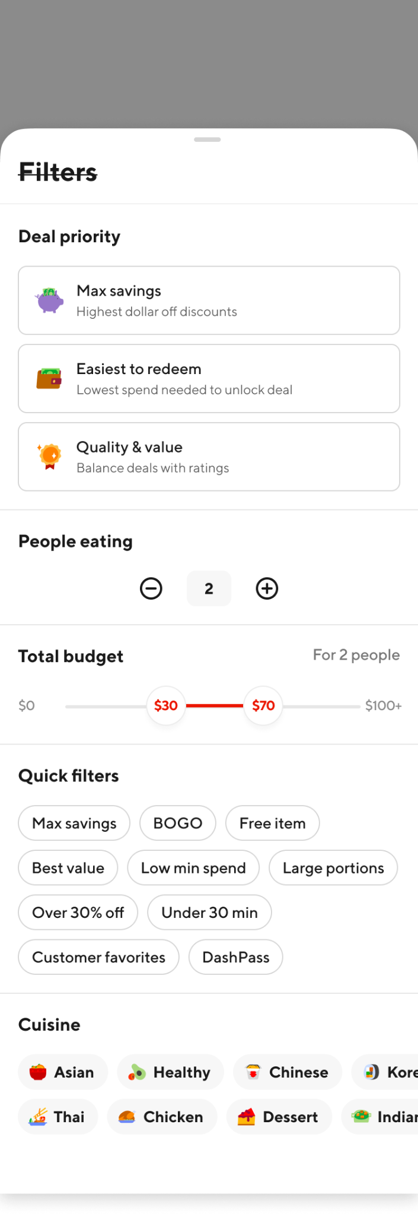
Concepts
Link to figma

Slide 7

Breaking Down
“Deals Discovery”

Slide 8
We must address the 3 main pain points around deal discovery
I need to visit the store page to understand a deal
I have to do too much thinking and mental math to find the right deal for me
There are not any/enough deals that are relevant or meaningful to me
*Note these pain points are consistent with other research conducted on deal seeking, item promos and the USI

Slide 9
We must think about the context; Cx either visit Doordash planning to select their Mx based on the deals available…..
“
I try to look for deals, say things that are discounted, even if it's just 15, 20 percent. Or even the $5 off of like the 15 or 20, something like that.
”

Slide 10
…OR they are Cx who have a cuisine or dish in mind but want to find a deal
“
I typically order from places I already know. So ones I know that are close so that my food doesn't get cold. Ones I know we like, ones I know that I do have a lot of issues
”

Slide 11
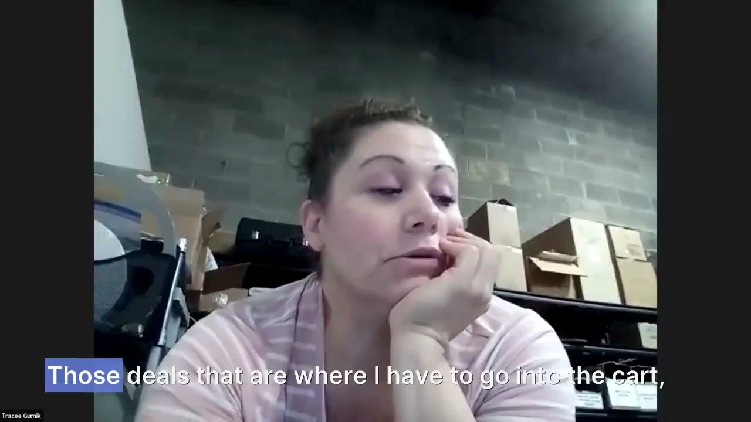
Today, deal discovery happens a lot later than we think…
Almost all of the Cx we spoke to said they most often learn about deals in the cart. They sometimes like at badges or carousels on the homepage but are not able to get the full picture of a deal there.

Slide 12
Today pill filters are not that helpful, and a little confusing
All of the Cx that we spoke with had used a pill filter at least once to narrow down their options. A few of the Cx we spoke to did not realize that you could select more than one pill at a time to narrow down results.
Cx had used the following pills:
Deals
Under 30 mins
DashPass
“
Once I go to search and click deals, like the amount of poke places is so much and there's like so many different kinds of deals, and then I'll just kind of get lost in here.
”

Slide 13


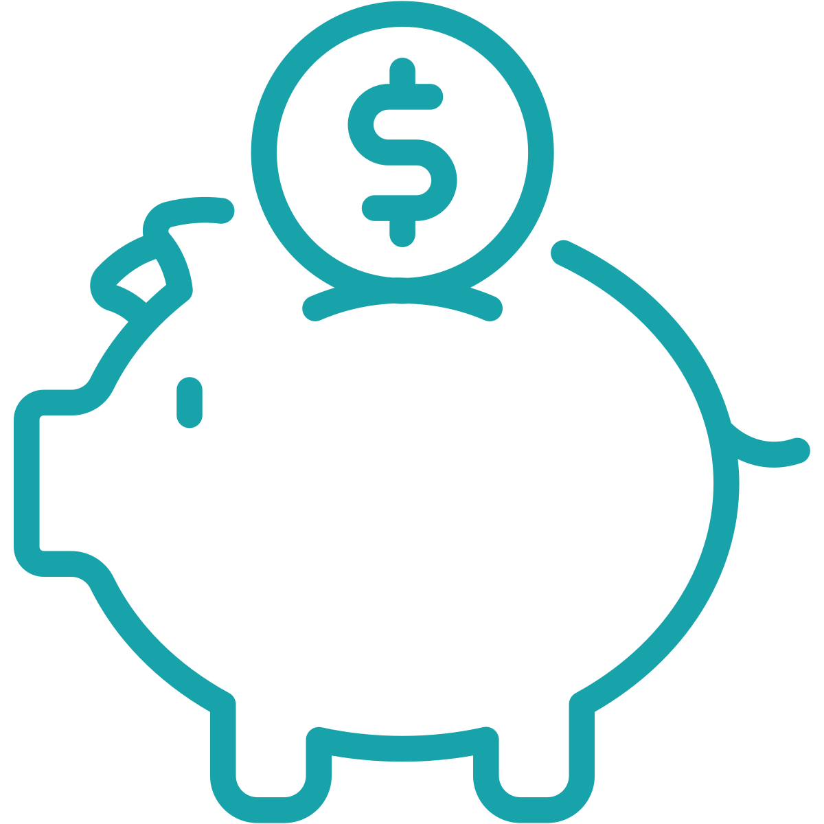


Discovery experiences should clearly address the top Mx selection criteria of deal seeking Cx
The highest savings available to me
The distance of the Rx/time until delivery
The cuisine type
The images
The restaurant quality
*Note these criteria are consistent with research around discovery and Mx selection

Slide 14
AI may be the future of deals discovery
“
When I don’t know what to order I’ll ask ChatGPT. I’ll say I want Korean food in zip code X, what should I get on DoorDash. It will tell me exactly where to go.
”
Learn more about Cx use of ChatGPT for DoorDash here

Slide 15
We need to Cx up for success around deal discovery as they transition from “New” to “MAU”
Cx is recruited to DoorDash with lucrative site wide offers
Unhappy with Mx specific deals provided on DoorDash app
Cx has been conditioned to think that deals via email are good deals and that deals on the app are not valuable or relevant.
*Note this is a unique scenario from one respondent who has recently switched from UberEats to DoorDash based on growth team offers

Slide 16

Research
Recommendations

Slide 17
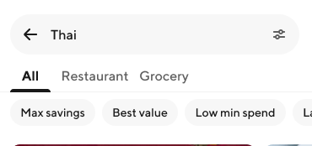
A “maximum savings” filter should be the top priority for a cupcake (and should be created before a BOGO filter).
WHY?
All Cx found the idea of filtering on the highest savings to be the most helpful. It let’s Cx look for things they find valuable without DoorDash having to assess value.
WHY NOT BOGO?
BOGO is not something that every customer finds relevant. Not all Cx need to order two meals or find themselves ordering the same meals. Additionally, this does not solve the major pain point of having to visit a store page to understand a deal.
IMPORTANT CONSIDERATIONS:
Results still need to be relevant. We need to consider factors such as dayparting, average minimum spend, preferred restaurants and cuisines and Mx ratings. Like anything on the app, a level of personalization is needed to build Cx trust.

Slide 18
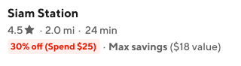
We should ALWAYS show deal minimums in badges or provide a minimum spend filter.
WHY?
Cx tend to fall into two camps- those that typically order a lot of food and naturally reach minimums and those that are only ordering for one and have difficulty reaching minimums. The second group is skeptical of deals with high percentages because they expect there to be a minimum they cannot reach. Without it, Cx who are sensitive to store minimums need to visit the store page to find this information.
IMPORTANT CONSIDERATIONS:
Ideally results will align with Cx expectations and take daypart into consideration.

Slide 19
Cx should “regularly” have deals available at their top restaurants
WHY?
We regularly hear from Cx that they do not see deals at the places where they want to order.
Cx who are coming to DoorDash looking for deals but know what they want to order, they expect DoorDash to provide deals at their favorite restaurants or want to be able to filter on these restaurants.
WHEN IS THIS HELPFUL IN DISCOVERY?
Cx would want to see Deals at favorite restaurants in scenarios where Cx search for a specific restaurant or dish but there is not a deal available for that Mx/item.
“
I hearted a restaurant and then nothing happened with it. I don’t even know where to find it.
”

Slide 20
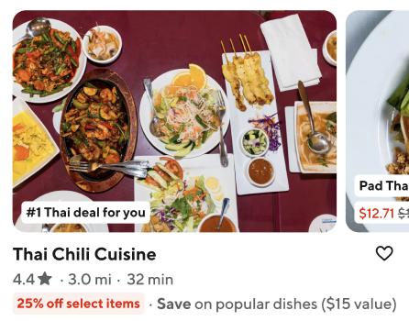
Top deal recommendations need a reason why
WHY?
While Cx noticed the #1 deal, #2 deal recommendations, they ignored them because they did not know what it meant.
Cx are very skeptical of why we are recommending something to them if it is not a Rx they regularly visit. We need to have a clear reason why we are recommending a deal, and explain it clearly and simply to Cx.
HOW DO WE DO THIS?
We need to go the extra mile of making it clear it is personalized to them individually, it should not feel auto populated. See additional insights around personalization needs here.

Slide 21
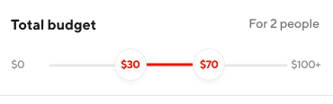
Avoid “budgeting” tools
WHY?
Cx get concerned about entering a budget. They do not understand the guardrails around the budget (e.g. are fees and taxes included) and are concerned they will miss out on a really good deal or Rx if they enter a budget.
HOW CAN WE HELP BUDGET MINDED CX?
These Cx are best served by affordable meals where they can clearly understand the cost of the food, fees and taxes.

Slide 22
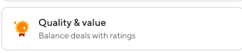
Avoid the term “value” in filters and search result descriptions
WHY?
Value can mean different things to different Cx, they will not try something they do not understand. Cx already feel like they have to “test” DoorDash recommendations are correct when descriptions are clear, they are not sure what to do when the descriptions are unclear.
HOW CAN WE ADDRESS VALUE?
Consider using clearly defined terms in support text in search results. Explore designs that stand out more to Cx.

Slide 23
Let’s not forget, we will need to educate Cx on their ability to search & filter!
“
I wouldn’t even think to search for deals when I am looking for a type of cuisine, you can’t do that today right?
”

Slide 24

Next Steps

Slide 25
First step…cupcake
Design team working on cupcake
UXR to test if cupcake goes “far enough”

Slide 26
Second step…a better discovery experience overall
Brainstorm session for longer term vision around discovery
Additional research around cart promo experiences and deal personalization

